Slide 1
Introduction to Machine Learning

Slide 2
Machine Learning
Supervised Classification
Clustering
Measurement Space -> Feature Space -> Decision Space.
Main Task:
Feature Selection
Supervised/Unsupervised Classification.

Slide 3
Supervised Classification
Classification
Two cases:
Class Conditional Probability density functions and prior probabilities are known.
Training sample points are given.

Slide 4
Bayes Decision Rule
K-Nearest Neighbour decision rule
Minimum Distance Classifier
C-Means Clustering
Agglomerative clustering (Single and complete linkage)
Divisive clustering
Objective function for feature selection
Probabilistic Separability (Chernoff, Bhattacharyya, Matusita, Divergence).
Inter Class distance.

Slide 5
Algorithm for feature selection
Sequential forward selection
Sequential backward selection
(l,r) algorithm
Branch and bound algorithm
Feature Extraction
Principal Component Analysis.
Fuzzy C-Means Algorithm
Fuzzy-KNN Algorithm

Slide 6
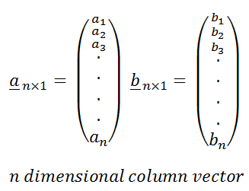
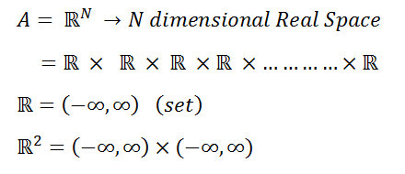
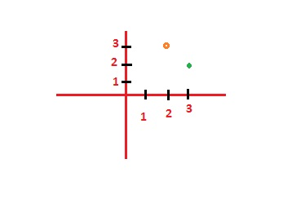
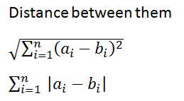

Vector Representation
2D Euclidean Space

Slide 7
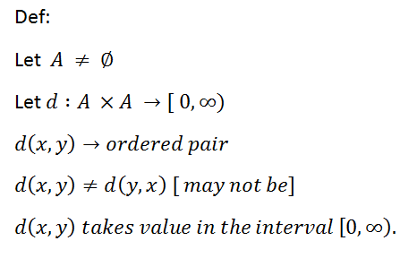
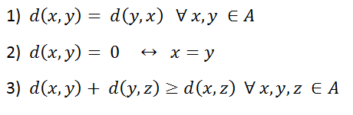
Properties of Metric
Triangular
Inequality
1). Distance is not negative number.
2) . Distance can be zero or greater than zero.

Slide 8
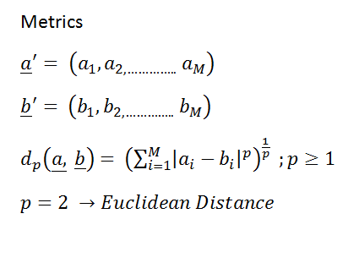
Dissimilarity Measures

Slide 9
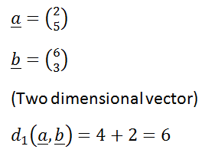
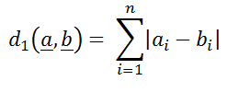
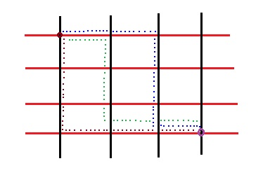
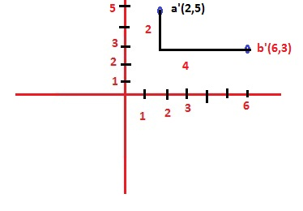
Example on Distance
City Block Distance

Slide 10
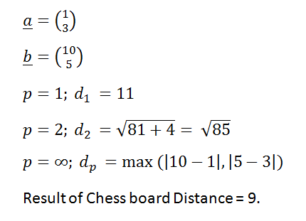
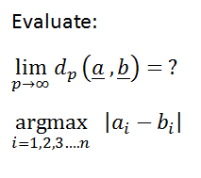
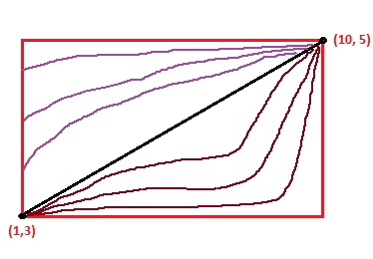
Chess Board Distance

Slide 11
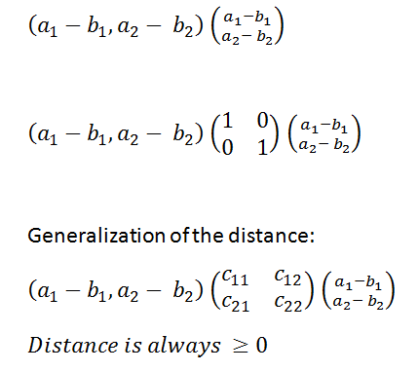
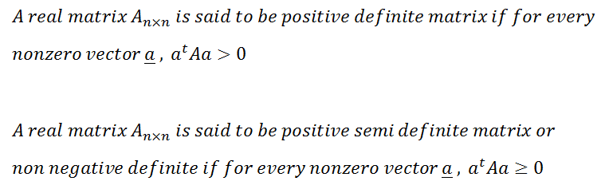
Representation of Distance

Slide 12
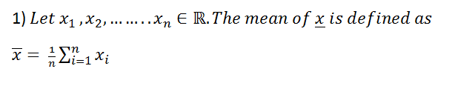
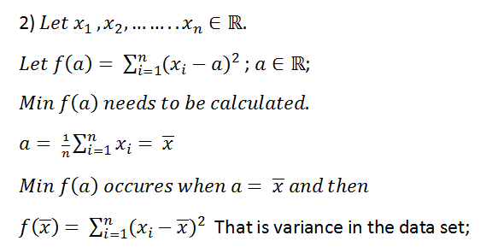
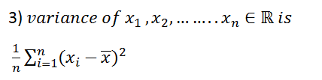
Basic of Statistics

Slide 13
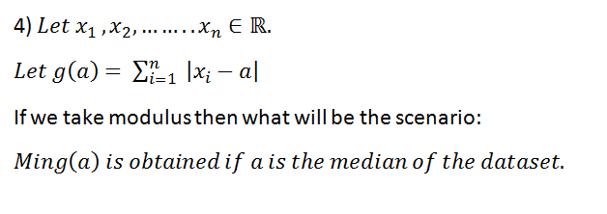
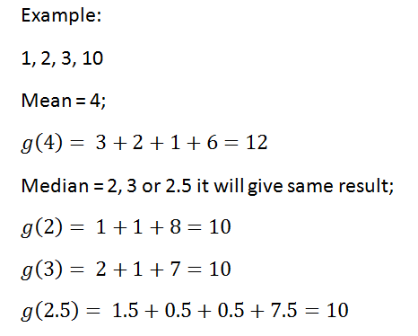

Slide 14
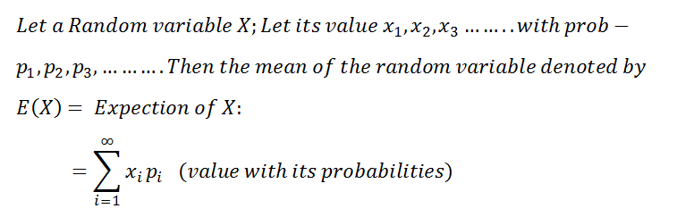
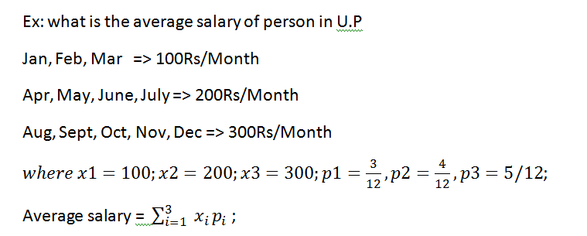
Concept of Probabilities

Slide 15
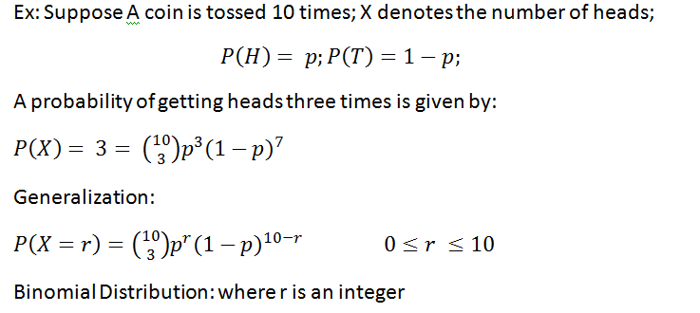
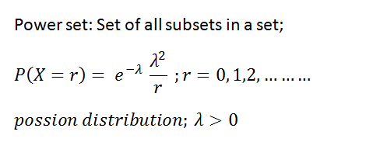

Slide 16
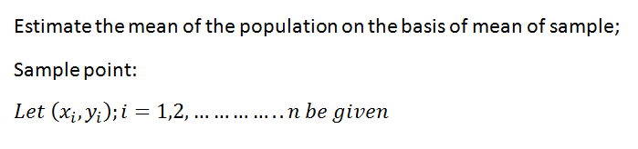
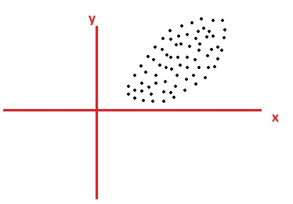
Concept of Covariance
Relationship of x and y on the basis of sample points

Slide 17
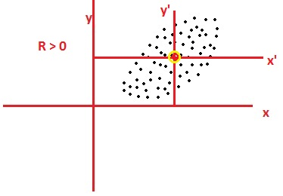
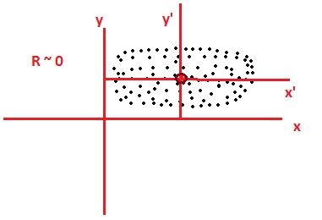
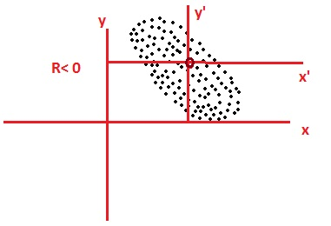
Case 1
Case 2
Case 3

Slide 18
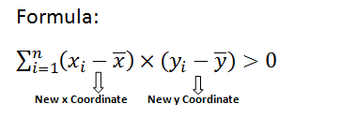
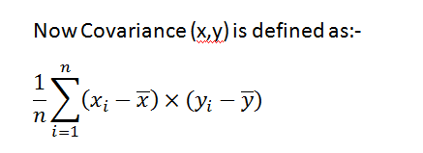
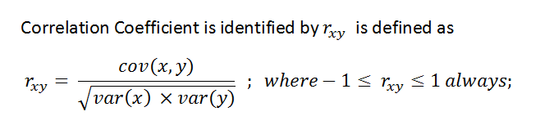

Slide 19
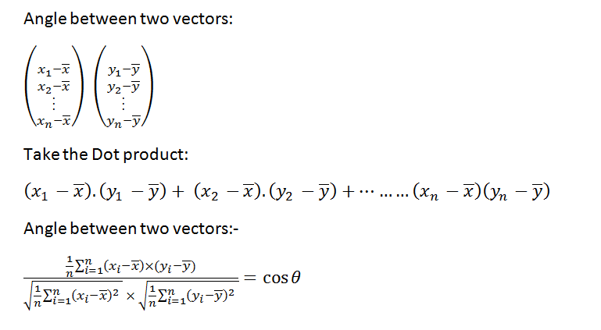
There is a proof using Cauchy Schwarz inequality

Slide 20
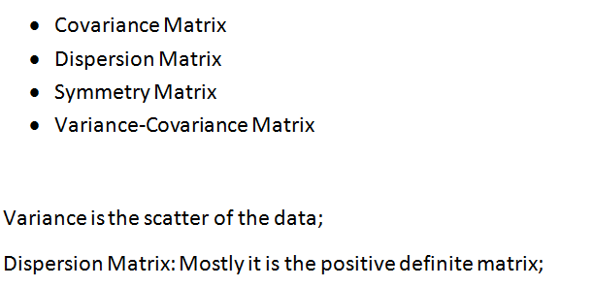
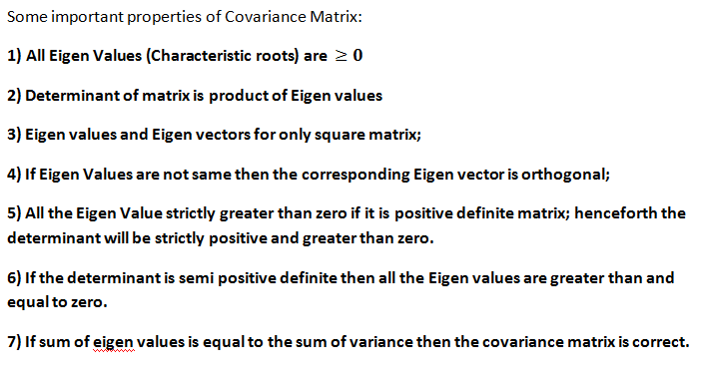

Slide 21
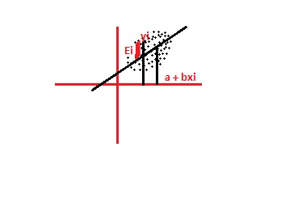
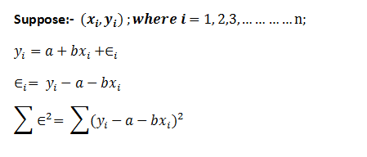

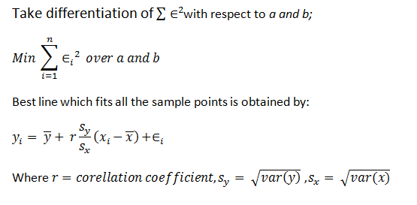
Concept of Linear Regression

Slide 22
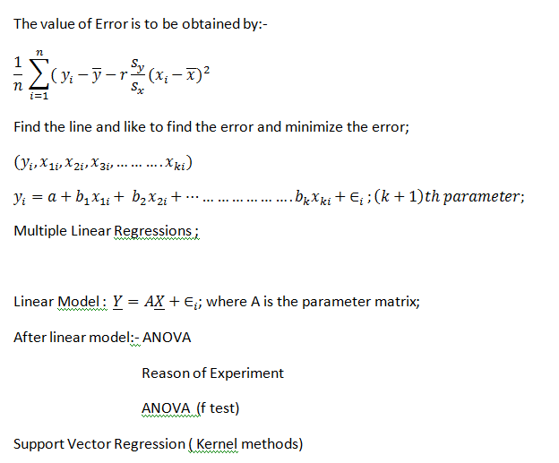

PR Book:- Christroph and Berger

Slide 23
Probabilistic Estimation
Unbiased Estimation
Maximum Likelihood Estimation
Unbiased Estimation: If Average of the value = original value is called unbiased.
Simple Random Sampling without Replacement (SRSWOR)
Simple Random Sampling with Replacement (SRSWR) is called i.i.d. That is Independent Identically Distributed.

Slide 24
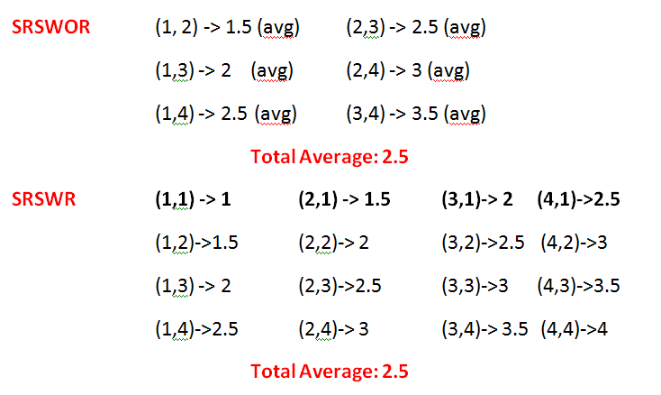
Example 1, 2, 3, 4; Average = 2.5

Slide 25
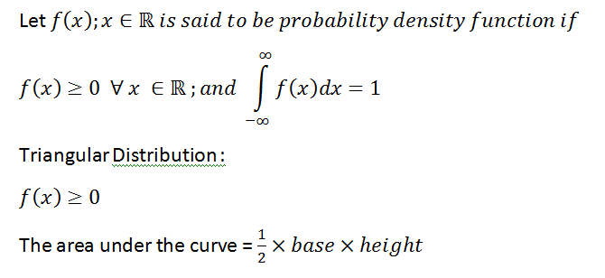
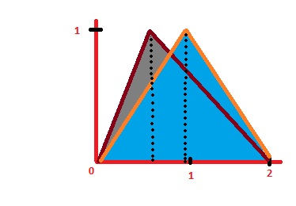
Probability Density Function

Slide 26
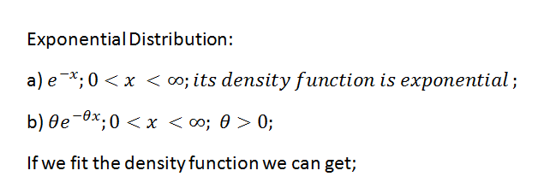
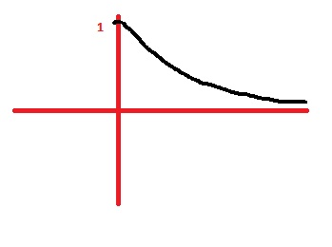


Slide 27
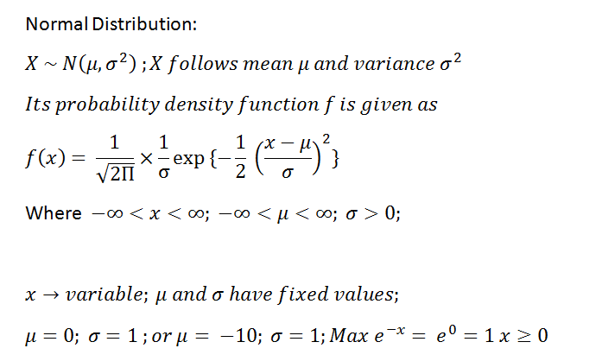
Normal Distribution
Stat Book: C. R. Rao: Linear Statistical Inference and its Applications

Slide 28
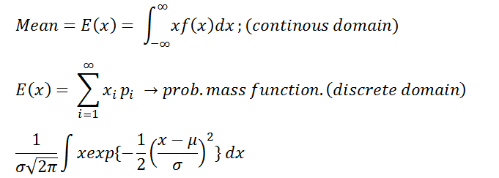
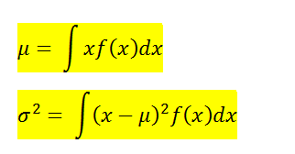
Bivariate Normal Distribution
Stats Book: Gun Gupta Dasgupta: Fundamentals of statistics Vol1. and Vol2

Slide 29
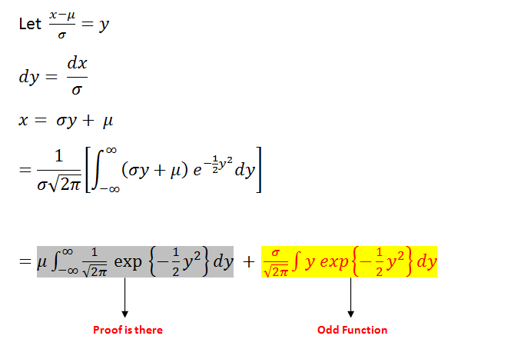
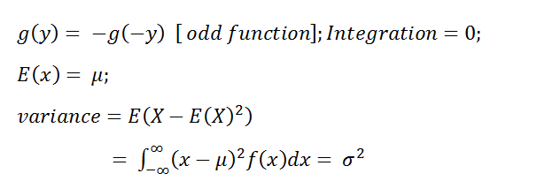

Slide 30


Multivariate Distribution

Slide 31


Recognition of Vowels in Speech

Slide 32


Machine Recognition of Pattern

Slide 33



Intersection in Two classes
Intersection in Three classes

Slide 34

Convex set and Non convex Set

Slide 35




Graphical Representation

Slide 36

Concept of Convex Hull

Slide 37




